Slide 1


Slide 2

Who are North Tyneside PCF?
Every local authority area should have a parent carer forum
Our core funding comes from the Department for Education, and we are independent
We are a Community Interest Company (CIC)
We are led by parent carers
We are here for parent carers of children and young people with special educational needs and disabilities (SEND) aged 0-25 years)
Here to represent the collective voices of Parent Carers

Slide 3



Who is a parent carer?
Parent carers provide support to their children/young people (0-25), including grown up children who could not manage without their help.
The child/young person can be ill, disabled, or have mental health or substance misuse problems.
As a parent carer, you are less likely to see yourself as a carer – and health and social care professionals are also less likely to see you as a carer.
This is important, because once you recognize you are a carer, and that your role may be causing additional practical, emotional or financial worries, then you are more likely to look for support – which is out there.

Slide 4
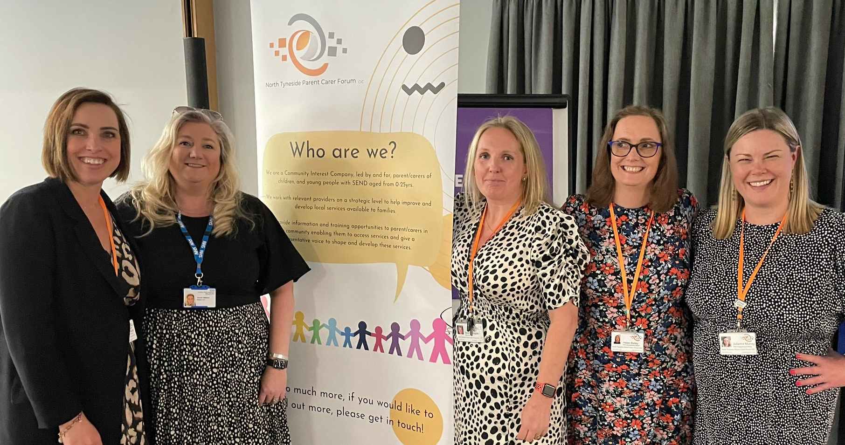
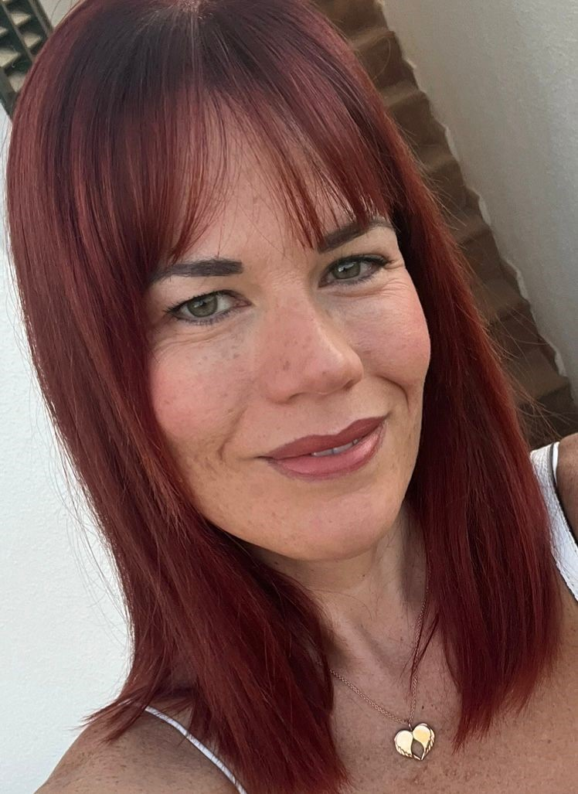
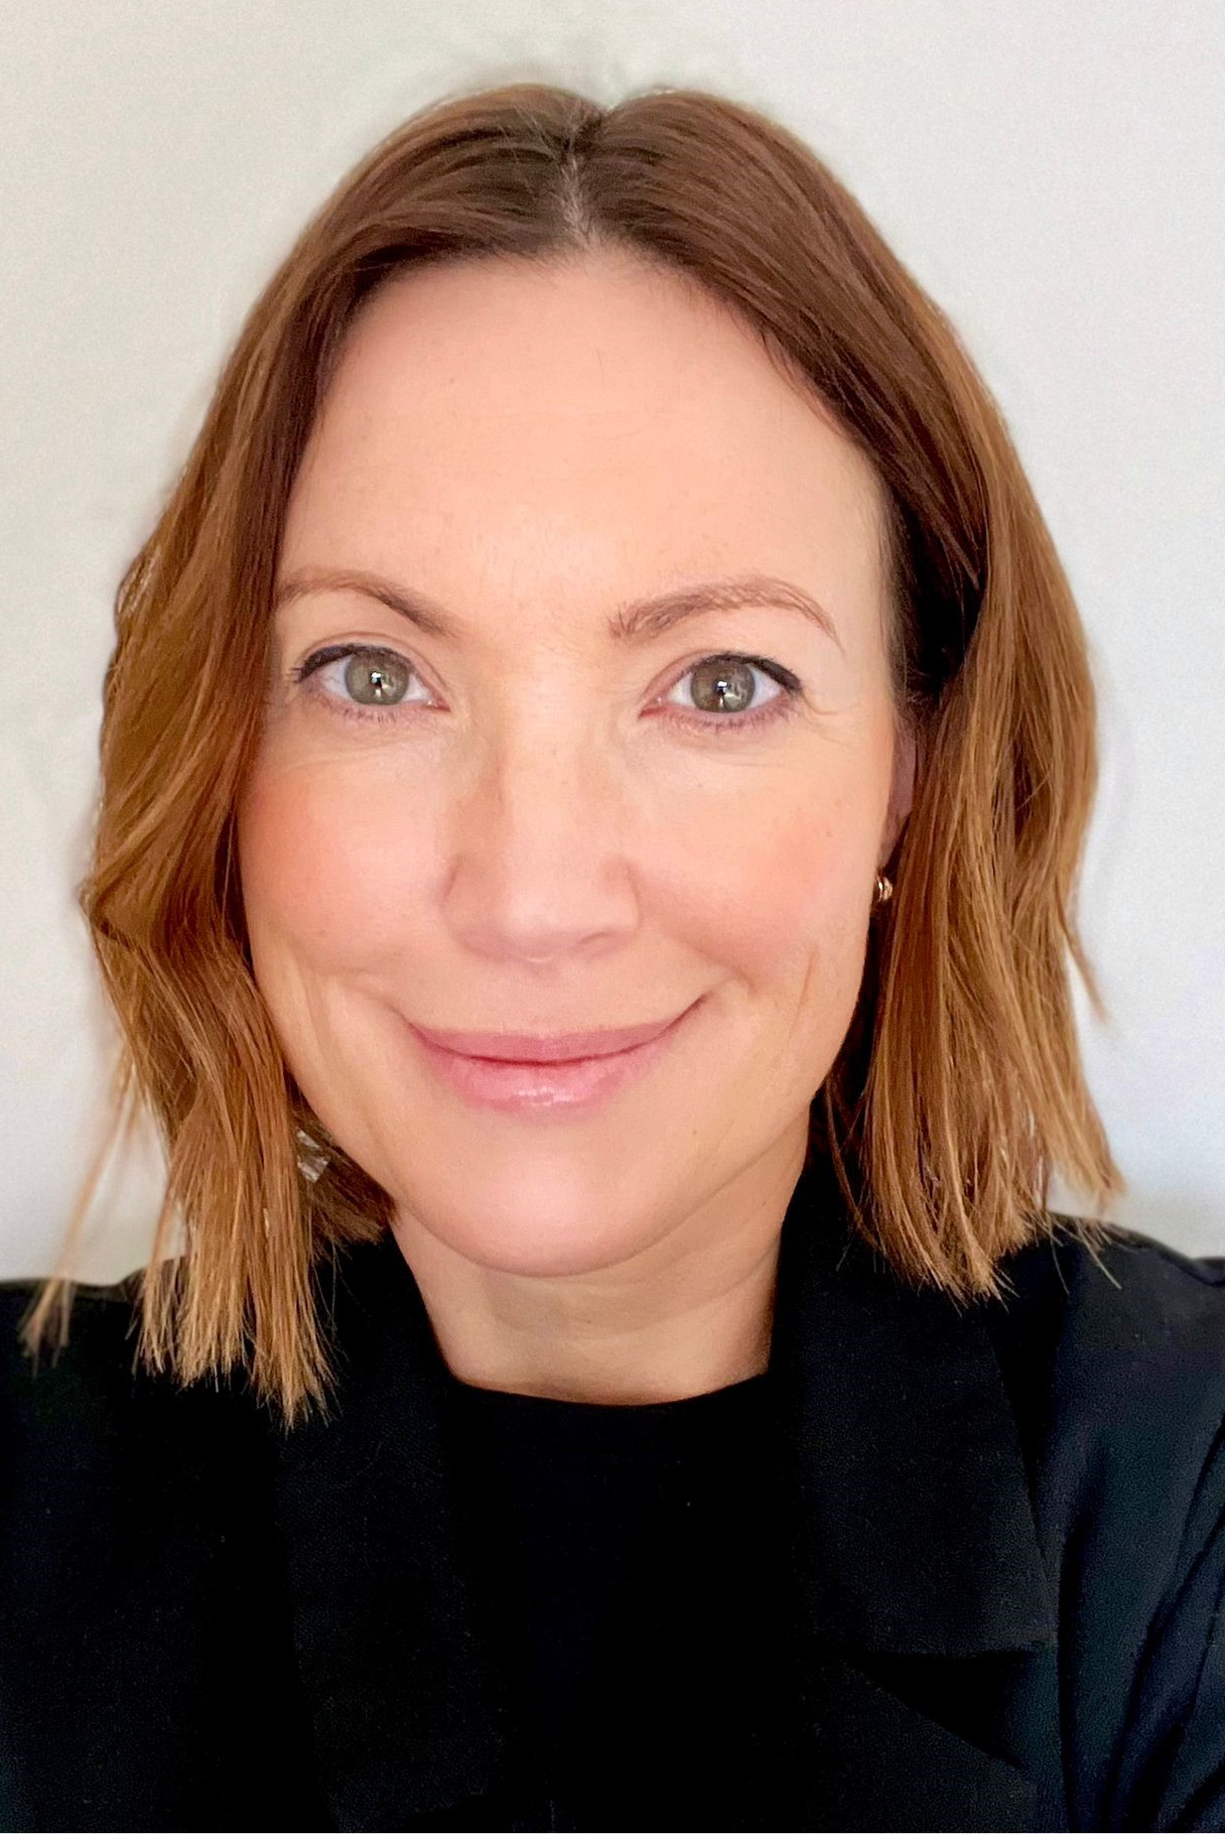
The team:
Jo - Strategic Director
Sarah – Operations Director
Patsy – Engagement Manager
Hannah – Peer engagement officer
Deborah – Peer engagement officer
Helen – Peer engagement officer
Julianne – Peer engagement officer

Slide 5

PCF Core Offer
Our core funding comes from the Department for Education.
Host/support drop in sessions
Work on a strategic level with LA/Health/Social Care
We arrange workshops and training sessions following parent carer requests (sleep/DLA/EHCP’s, post 16)
We facilitate consultations with local council and NHS (most recently on Graduated Approach, Transport, ARP’s and the Local Offer)
We can tell you what is available in the area and how to access these services
We collect the information which is shared to us by parent carers, and it helps decide what our main priorities are
We work strategically alongside local services, the Local Authority, Education, Health and Social Care
If you have any feedback on services and how to improve them, we would like to hear from you

Slide 6

Some of our events:
Annual PCF Conference
DLA Workshop
Sleep Workshop
SEND Green paper
Transport Consultation
SEND & Early years
Safety Valve
Introduction to PBS
Early Years Consultation
ARP Consultation
Graduated Approach Consultation
Graduated Approach Launch
Local Offer Consultation (ongoing) Coming Soon:
Puberty, relationships and SEND
SEND after Early Years
Annual Conference

Slide 7

Why are we here today?
At our annual conference last year, parent carers asked for more peer events in school.
We made an application to our local NHS to ask for funding to support these sessions.
We were awarded funds to support 40 schools within North Tyneside and your school asked to be one of them!
Introduction and then 5 bespoke sessions in your school. What do you want from these sessions?

Slide 8
What would you like
from these sessions?

Slide 9

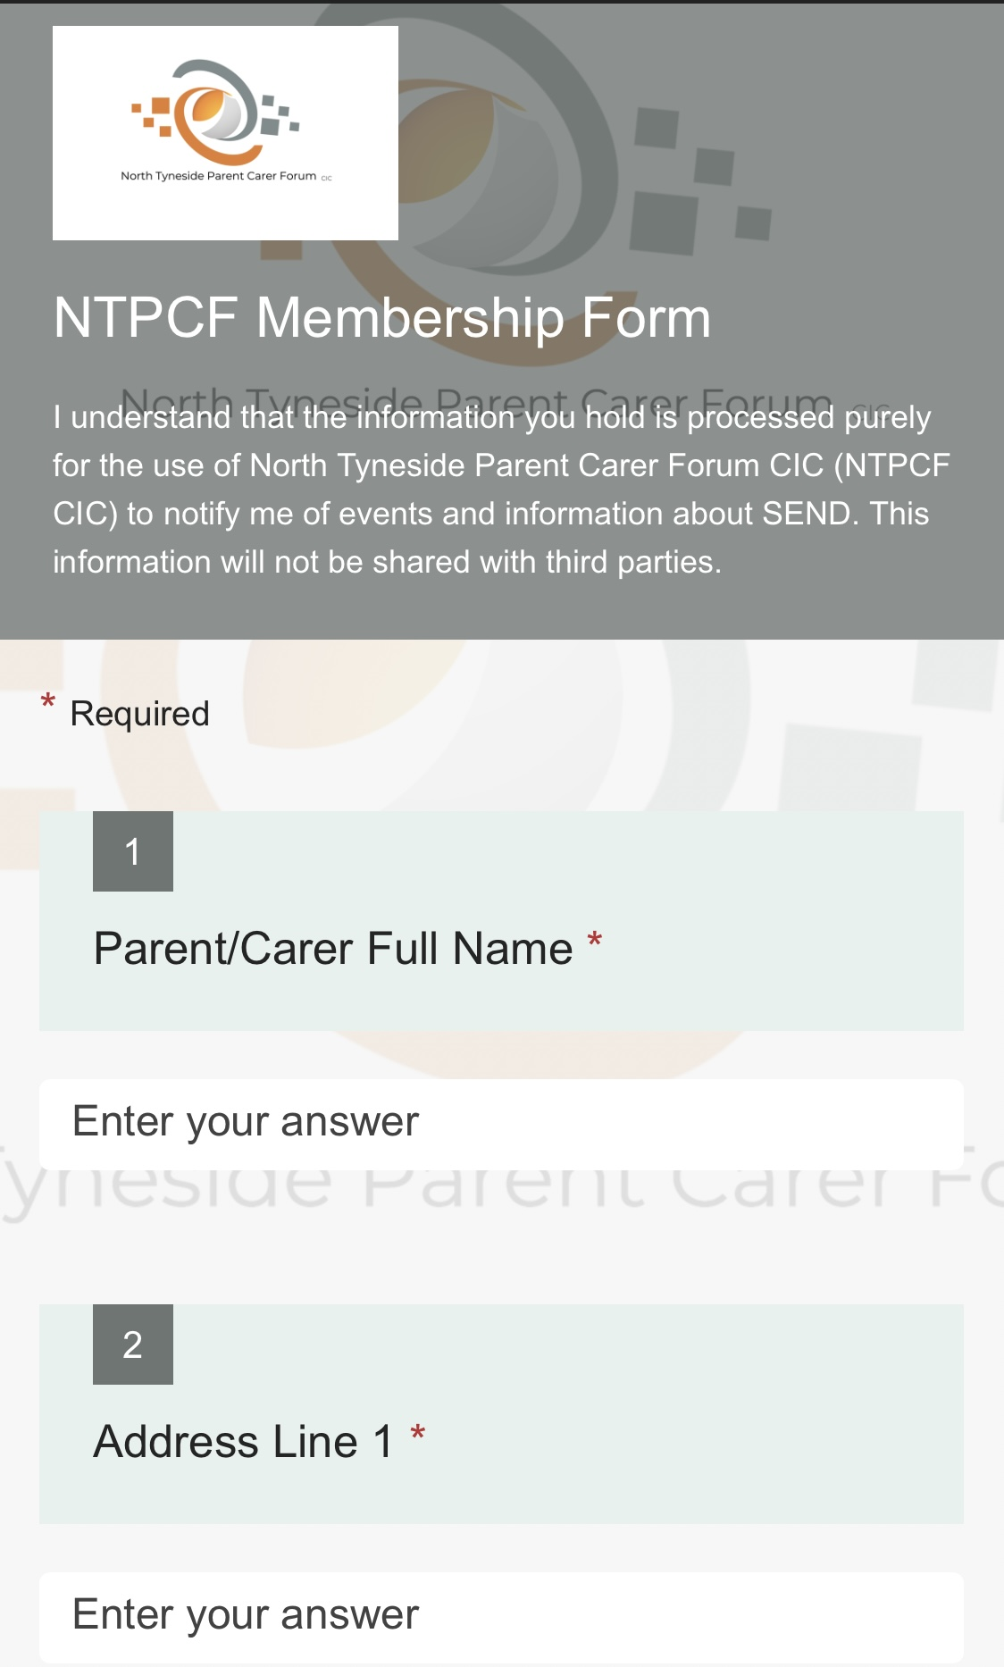

How do you find us?

Slide 10
Our Contact Details
Text/phone: 07572 787 044
info@ntpcf.co.uk
www.ntpcf.co.uk

Slide 11

Thank you! Any Questions?

