Slide 1
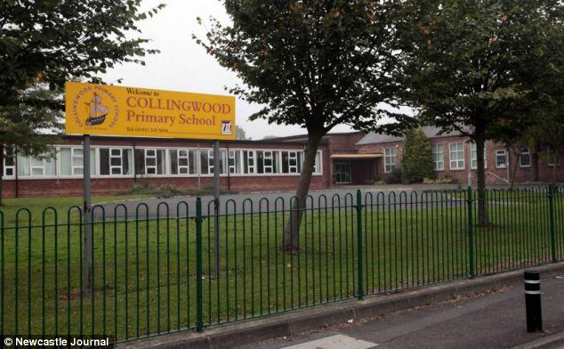
How to use Google Classroom

Slide 2
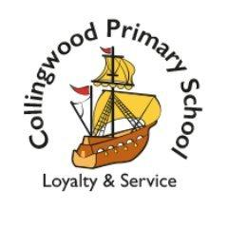
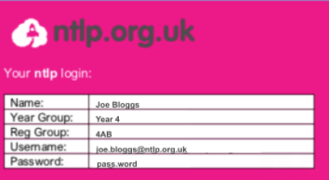
Google Classroom
To access Google Classroom children need to login to their new Gmail account. This is on: gmail.com
They then enter their email address and password (in their home login sheets). Please do not hesitate to contact us if your child has lost their login details.
An example login looks like this:
You will be able to upload pictures of your work that you have completed and send it to your teacher. Notes can also be added. If you need help or any further support please contact the school office by telephone or email.

Slide 3
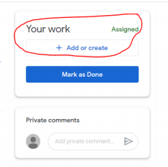
Google Classroom
Once logged into Gmail, you need to click the 9 dots at the top right of the screen and then click on the Google Classroom icon:
Then click on the children's class.
All messages will then appear on this screen and the class work icon at the top.
Once logged in you can upload a file or picture of the work completed by pressing add or create.
If you have more than one child in school, please make sure you fully log out of all tabs before logging on as a different child.

Slide 4
Website: https://www.collingwoodprimary.org.uk/
Twitter: @Collingwood_PS

